Slide 1


Assessing the Spatio-Temporal Accessibility of Pharmacy Care in Vermont, USA
Sam Roubin¹, Joseph Holler¹, and Peter Kedron²
¹Department of Geography, Middlebury College
²Department of Geography, University of California Santa Barbara
AAG 2024, April 16th
Notes:
Thank you everyone for being here Today. My name is Sam Roubin – I recently graduate Middlebury College in Februrary, and I pursued this research throughout my last semester with my professor in the Middlebury Geography department , Dr. Joseph Holler, who I'd like to thank forhis continued support throughout this process . Today, I'll be talking about Our study: “Assessing the Spatio-Temporal Accessibility of Pharmacy Care in Vermont, USA” .

Slide 2
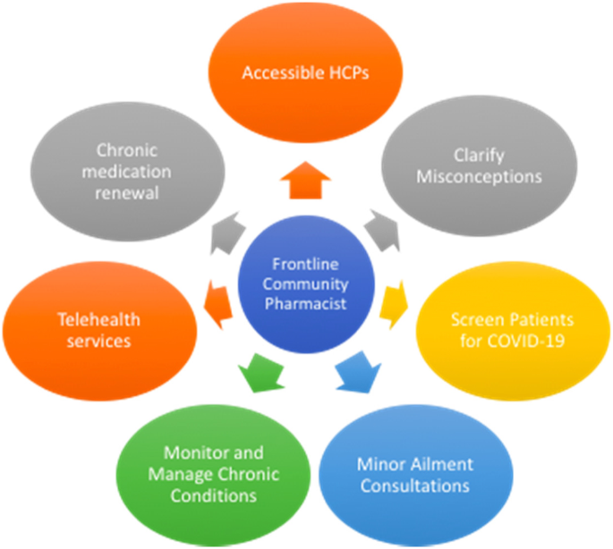
Why does access to pharmacy care matter?
Increasingly important part of primary healthcare
Valuable for reaching underserved and rural populations (San-Juan-Rodriguez et al., 2018; Berenbrok et al., 2022)
Elbeddini, A., Prabaharan, T., Almasalkhi, S. et al. Pharmacists and COVID-19. J of Pharm Policy and Pract 13, 36 (2020). https://doi.org/10.1186/s40545-020-00241-3
Notes:
I first wanted to start with a quick overview on why access to pharmacy care is so crucial…
In recent years, pharmacy care has become an increasingly important component of primary healthcare. And this is largely because pharmacists have transitioned beyond their traditional role in solely medicine dispensing to an increasingly clinical role focused on patient-centered care. Most recently, pharmacists across the US have played a massive part in the fight against Covid-19. This figure here on the right from a 2020 study on the role of pharmacists in the pandemic highlights that pharmacists can monitor and manage chronic conditions, clarify health misconceptions, screen patients for diseases (infectious and chronic), deliver vaccines, as well as other responsibilities. And, Evidence has also shown that pharmacists are particularly valuable for reaching underserved and rural populations, as they as are typically conveniently located in community settings, have extended operational hours, and don’t require appointments.

Slide 3
Study Purpose:
To understand how spatial access to pharmacy care varies temporally across Vermont, specifically focusing on identifying areas of the state with particularly limited access.
Notes:
Against this backdrop, our study’s purpose was to understand how spatial accessibiloity of pharmacy care varies temporally across Vermont, specifically focusing on identifying areas of the state with particularly limited access.

Slide 4
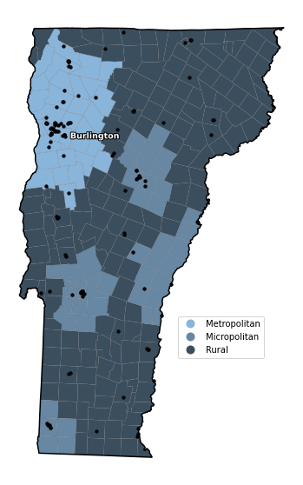
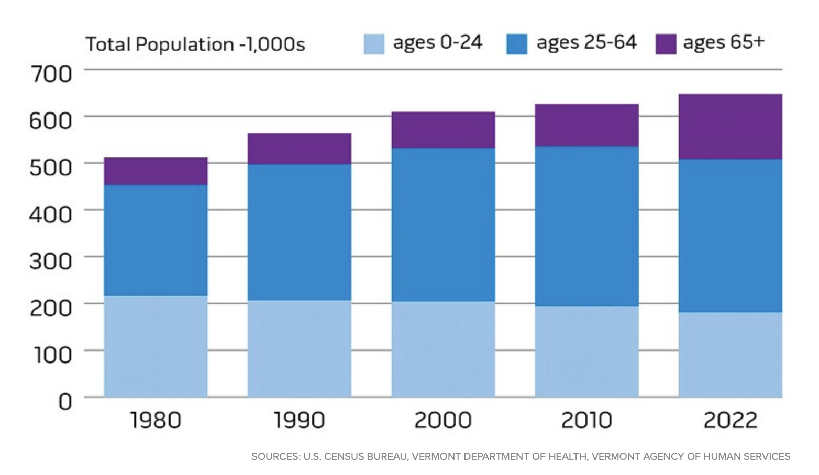
Study Area
Highly rural and aging population
255 total municipalities
35 metropolitan (1 area)
48 micropolitan (4 areas)
172 Rural
117 VT pharmacies, 75 Out-of-Sate
Figure 1. Study area with metropolitan, micropolitan, and rural
classifications for county subdivisions and pharmacy locations
Notes:
So when thinking about our Vermont study area, its important to note that Vermont is the most rural state in the US in terms of proportion of population living in non-metro towns, and it’s also a rapidly aging state as shown in the figure below/ And this demographic landscape really increases the significance of our study.
The study area figure on the right demonstrates the distribution of metropolitan towns in light blue, micropolitan towns in the medium blue, and rural towns in dark blue/grey across Vermont. The black dots represent the 117 VT pharmacy locations, and what we can see before even running our analysis is that pharmacies tend to be clustered in Metropolitan and micropolitan areas, which follows logic. We also included 75 out-of-state pharmacies close to the border in this study.
So this leads me to our research questions.

Slide 5


Research Questions
1. Do certain areas of the state exhibit particularly limited access to pharmacy care during typical business hours?
2. How does the accessibility to pharmacies fluctuate across different temporal segments of the day, various days of the week, or combinations of these temporal dimensions?
3. Presuming that we have observed differences in pharmacy accessibility in rural areas, are spatial differences in access exacerbated outside of conventional business hours?
Notes:
Our first question, which was focused on just the spatial component of pharmacy accessibility was:
Our second research question, focusing on the temporal dimensions of accessibility asked:
And combining these two questions, we finally asked:

Slide 6
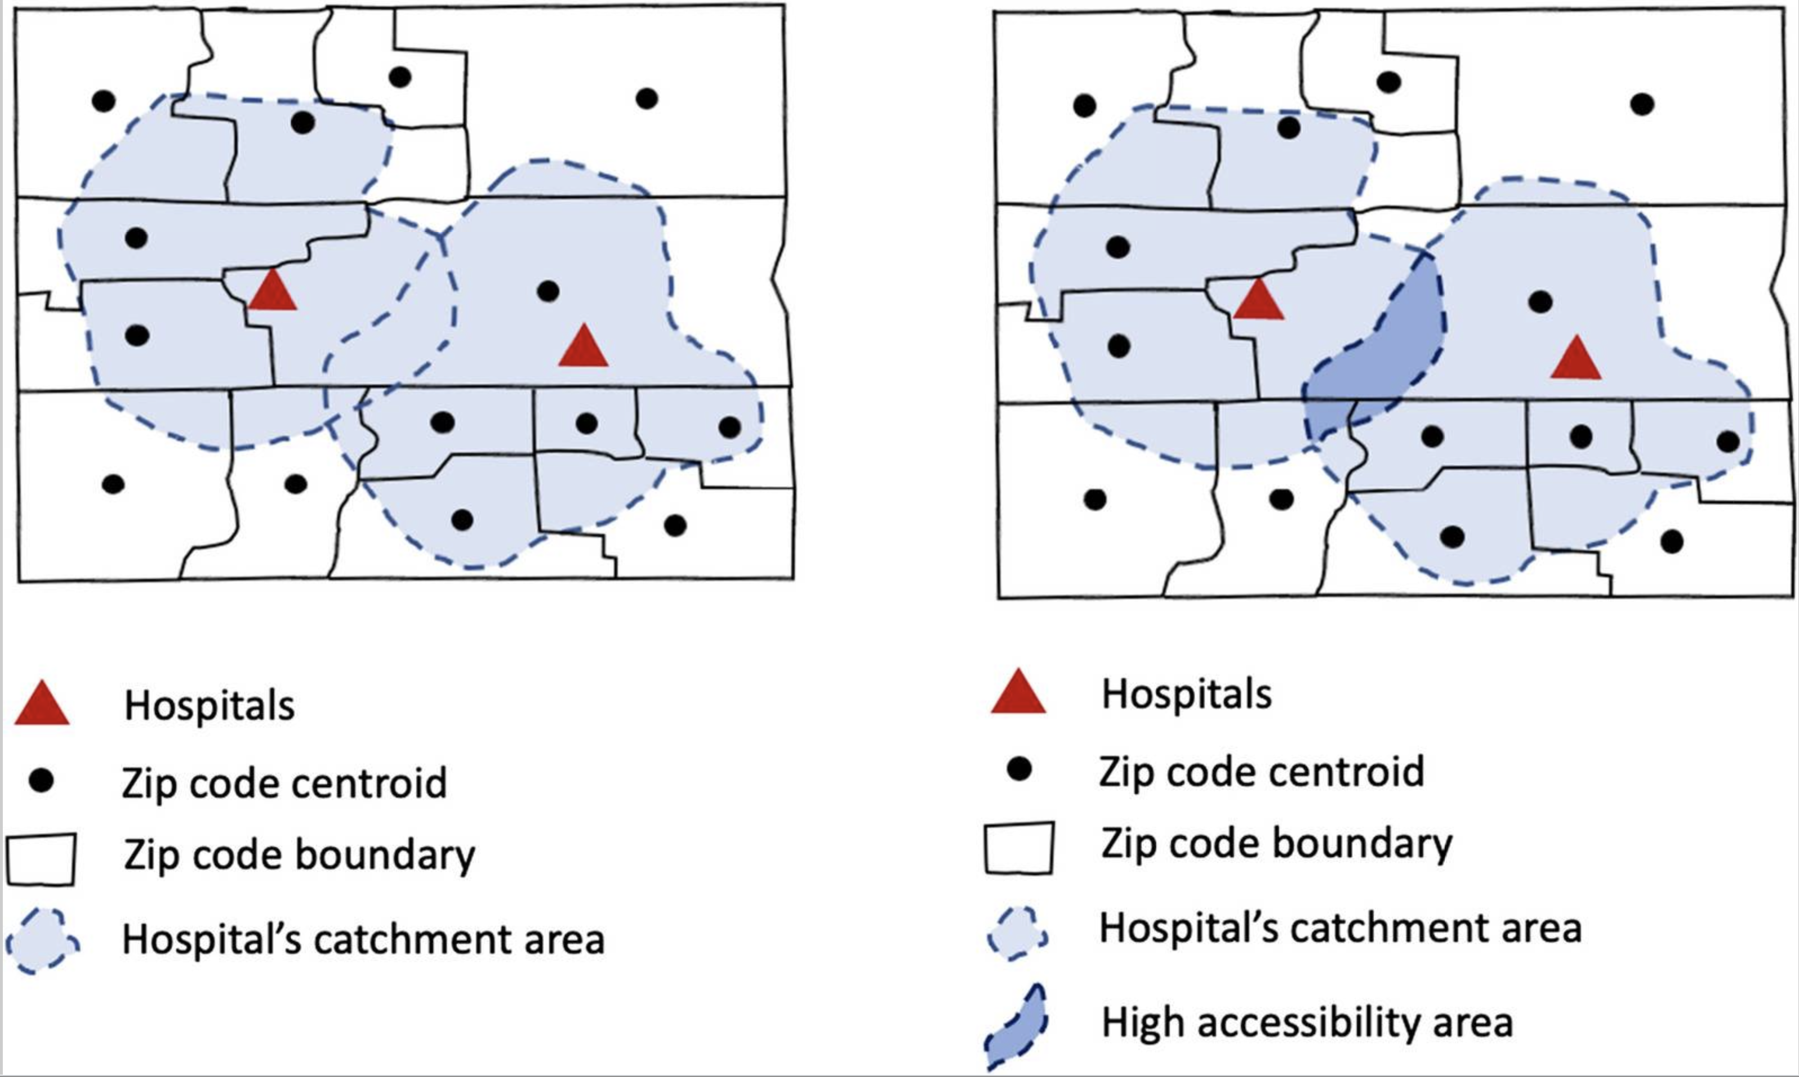
Method: E2SFCA (Enhanced 2-Step Floating Catchment Area Method)
Enhanced - 2SFCA (Luo & Qi, 2009)
Supply, Demand, Human Mobility
Step 1: Service-to-population ratios within individual service catchments
Step 2: Sum ratios within population areas
Accounts for varying distances within a catchment area
Kang et al., 2020
Notes:
So before we get into specifics I want to talk a little bit about the fundamental method we used in this analysis, which is the Enhaced Two Step…
This is one of the most common and widely accepted methods for assessing spatial accessibility to healthcare resources these days. And it has really become a preferred method because it takes into account supply, demand, and human mobility, and their interactions, unlike many simpler methods for calculating spatial accessibility and on top of this, it’s is relatively intuitive and easy to interpret. Its called the 2-step floating catchment area because it functions in two major steps. First, service or provider-to-population ratios are calculated within individual service catchments, and these catchments are determined by a threshold travel time from the service provider. In our study we used a thirty minute driving time from pharmacies to determine the outer boundary of these catchments. The figure on the right shows two service location with their respective catchments, and it illustrates how the overlapping of these catchments results in relatively higher accessibility areas. And then in the second step, all of these ratios are aggregated in the geographic units of interest to create a relative accessibility measure. Importantly, the Enhanced part of the Enhanced 2sfca method comes from the fact that this method considers distance decay within individual catchment area, so areas with closer driving times to the service location are weighted more heavily than those farther away within the catchment.

Slide 7
Data and Methods
Supply (Service)
Demand (Population)
Mobility
Pharmacy Staffing
(Primary Data)
Population Data
(Secondary Data)
Road Network
(Secondary Data)
Survey pharmacies in VT on staffing and hours for weekdays, Saturdays, and Sundays
Collected data for 87%
US Census Bureau ACS 2018-2022
Total pop. at town-level
Town classifications as metro, micro, or rural
OSMnX road data
Speed limit data + distances → travel times
E2SFCA
CyberGIS – Jupyter
Temporally-explicit
Town-level Accessibility Scores
(Relative Values)
Notes:
Three sources of data:
Our first dataset was primary data that We collected on pharmacy staffing and hours of operations on Weekdays, Saturdays, and Sunday through successfully surveying 87% of pharmacies in Vermont during the Fall of 2023.
Our population data set came from the US Census Bureau and included total population at the town level as well as town classifcations as metro, micro, and rural
Using the python packacge OSMnX allowed us to pull the road network data from our study area into our analysis. And what this allowed us to do was gather speed limit data and travel distances, which were then used to derive travel times ultimately informing the travel times from our pharmacy locations.
Applied the E2SFCA method in a temporally explit manner, meaning we ran the model for every hour between 7am and 10pm on each day. And we did this in the CyberGisX-jupyter cyber infrastrcutre, wehre we actually adpapted and extended the code from a former spatial accessibility study of Covid-19 healthcare resources in Illinois during the pandemic by Kang et al.
Highlight relative values with scores for multiple hours in the day and days of the week

Slide 8
Results

Slide 9
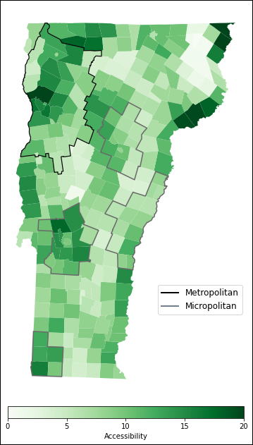
Question 1: Spatial Dimension of Access
Town Type | Mean Weekday Accessibility
Metropolitan | 10.7
Micropolitan | 10.4
Rural | 8.7
Some of the highest accessibility found in metro / micro regions
3% and 20% decreased access for micro and rural towns compared to metro
Significant difference in mean access:
(H(2) = 15.2, p < 0.05)
Figure 2. Spatial accessibility during conventional weekday business hours
Notes:
When we ran the model on weekdays during a time when all pharmacies are open, which represents a period of maximum accessibility, we saw that … . When we quantified these diffeernces, we found that micropolitan towns only had 3% lower mean accessibility, while rural towns experienced a 20% decrease in mean accessibility.

Slide 10
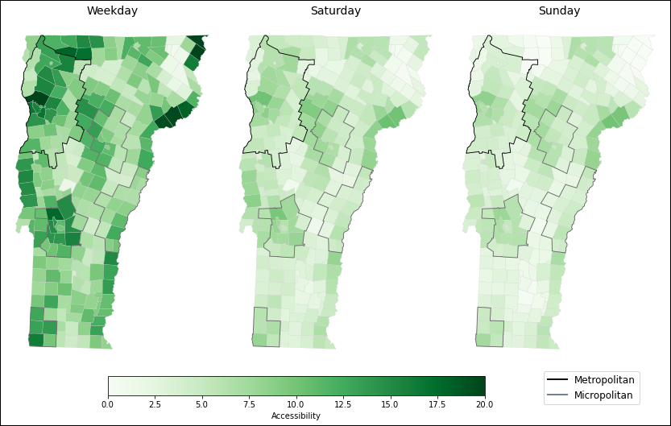
Question 2: Temporal Dimension of Access
49% and 60% decrease in mean access on Saturday and Sunday, respectively
Significant difference in mean access:
(H(2) = 308.2, p < 0.05)
Day | Mean Accessibility
Weekday | 9.3
Saturday | 4.7
Sunday | 3.7
Figure 3. Spatial accessibility maps by day of the week.
Notes:
When we analyzed the temporal dimension without considering urban rural difference, we saw that there was a:
This figure on the right demonstrates the overall decrement in accessibility on weekends. But importantly, it also shows large swaths of areas across the state that are left with virtually no accessibility to pharmacy care on the weekends, shown by the very light areas.

Slide 11
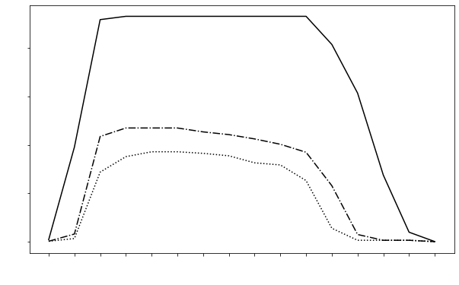
Question 2: Temporal Dimension of Access Cont.
Weekday
Opening
Extended hourly accessibility on weekdays – Earlier + later access
Saturday
Sunday
Closing
Figure 4. Mean spatial accessibility throughout hours of the day, broken down by days of the week.
Notes:
Now, when we look at access by hour of the day instead of days of the week, we get quite a granular picture of the temporal dimensions of pharmacy access. This figure shows Mean accessibility across hours of the for Weekdays, Saturdays, and Sundays. What is really key in this figure is that pharmacies are accessible earlier and later on Weekdays than on the weekends. Mean accessibility across the state drops to virtually zero by 6 pm on Sundays, whereas accessibility does not drop to this level until 9 pm on Weekdays.
So, as expected, we see significant differences in access both across days of the week generally and between hours of the day on different days.

Slide 12
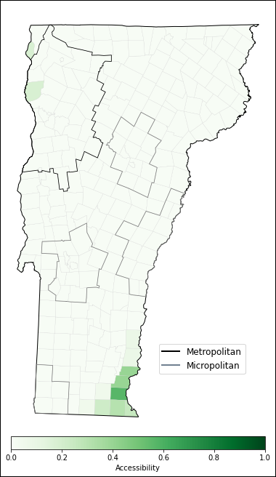
Late-Night Accessibility
24-hour pharmacies provide consistent access to essential medicines
May more significantly impact:
People with chronic conditions
Families with children
People facing emergency situations
Zero 24-hour pharmacies in Vermont
Compared to 4.9% of pharmacies nationwide (Qato et al. 2017)
Figure 5. Late night accessibility (between 10pm and 7am).
Notes:
We also looked at Late-night pharmacy accessibility, as 24 hour pharmacies provide consistent access to essential medicines and are particularly important for people with chronic conditions, families withi children, and people facing emergency situations. What we found was there were there is no access to pharmacy care across the state in this time period, except for a very limited number of towns in the Southeast because of two 24-hour pharmacies that are nearby in NH. There were no 24-hour pharmacies in the state of Vermont, compared to 4.9% of pharmacies nationwide being open 24-hours.

Slide 13
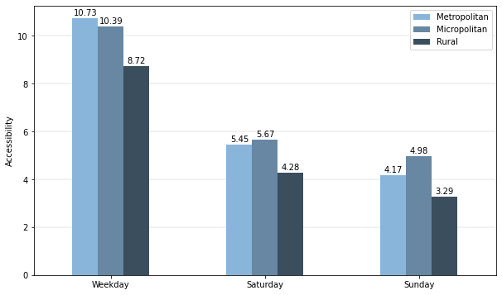
Question 3: Spatiotemporal Variation in Access
Urban-Rural accessibility differences exacerbated on Saturdays and Sundays
Micropolitan access greater than metropolitan on Saturdays and Sundays
Town Type | Mean Weekday Accessibility | Mean Saturday Accessibility | Mean Sunday Accessibility
Non-Rural | 10.5 | 5.6 | 4.6
Rural | 8.7 | 4.3 | 3.3
Difference | 17% | 23% | 29%
Figure 4. Mean Accessibility on weekdays, Saturdays, and Sundays, broken down by metropolitan, micropolitan, and rural subdivisions.
*Non-rural group created by taking a weighted average of
metropolitan and micropolitan
Notes:
When we combined our spatial and temporal questions, analyzing how urban-rural differences changed by day of the week, we found that indeed rural-urban accessibility differences were exacerbated on the weekends, with differences being the greatest on Sunday. As you can see here, the difference was 17% on weekdays, 23% on Saturdays, and 29% on Sundays.
And then when we look at this bar graph on the right of accessibility by day of the week for each town type, there was one unexpected result we encountered, which was that micropolitan towns actually had a greater mean accessibility to ppharmacies on the weekends than metro towns. And we suspect this is because micropolitan towns experienced similar closures of pharmacies to metro, but because of their lower populations, the service-to-population ratios were slightly greater, leading to greater accessibility.

Slide 14
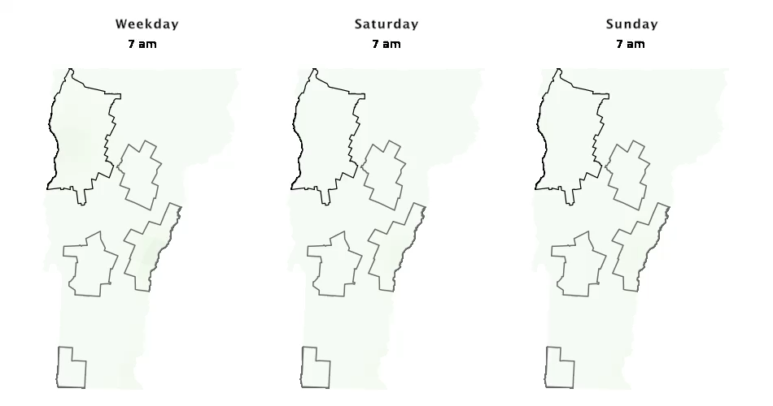
Quesition 3: Spatiotemporal Variation Cont.
Notes:
What you’re going to see here is an animation of how accessibility changes every hour from 7 am to 10 pm on Weekdays, Saurdays, and Sundays side-by-side. With The metro amd micro clusters outlined. I’ll let it play through once and then Ill highlight a couple of key things.
This animation, I think, is pretty effective at illustrating the spatiotemporal dimensions of accessibility across Vermont and summarizes a lot our findings. Besides the clear disparity in overall access on weekends and the fact that weekday pharmacy care is available earlier and later in the day, we also see the relative change between rural and non-rural towns throughout the day. So for exampleif you look at Saturday and Sunday between … , we can see that access is falling disproportiantely outside of the outline areas in the rural towns. And then on weekdays, access remains later in the day within non-rural towns ( 7pm and 8pm).

Slide 15
Conclusions
1. Rural towns had lower accessibility measures to pharmacies during all temporal segments.
2. Temporal dimensions of access (particularly diminished weekend access) had a more significant impact than the rural-urban distinction on overall access to pharmacies across VT.
3. Urban-rural disparity in access was exacerbated on the weekends.
4. This has potentially important implications for public health planning.
Notes:
I wanted to finish with some of our major conclusions:
We found that :
Our results indicated that :
And lastly, that:
This knowledge is valuable so that health care policy can be crafted to address some of these disparities and improve Vermont resident’s access to care.
- In particular, Extending hours of operations and increasing pharmacy staffing on weekends across select Vermont pharmacies may substantially improve Vermont residents' access to essential medications and healthcare services
- And our study suggests that These efforts should focus on VT’s rural regions, considering the exacerbated urban-rural access disparity.

Slide 16
Thank you. Questions?
sroubin@middlebury.edu , jholler@middlebury.edu

